Slide 1
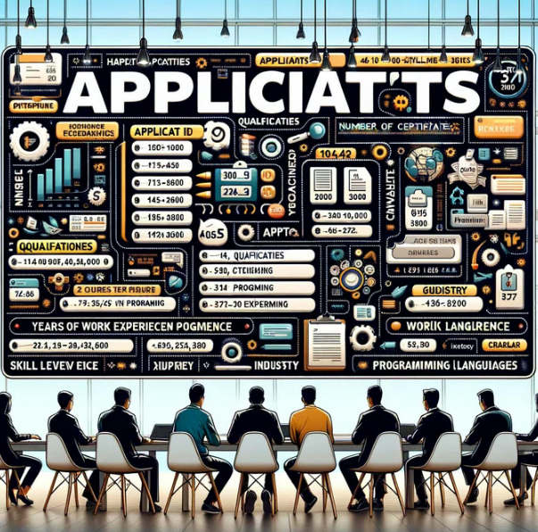

Slide 2


Slide 3
Datasets
Applicants Dataset: Include fields such as preferred industry, job type (full-time, part-time, freelance), and location preference to better match with job postings.
Jobs Dataset: Add details like job type (full-time, part-time, freelance), required soft skills, and a brief job description for better matching with applicants' profiles.

Slide 4


Slide 5
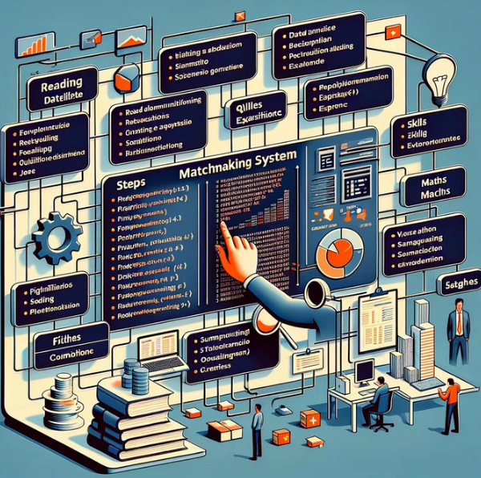

Slide 6
Ideas for the Matchmaking System
Skill Matching: Match applicants to jobs based on the compatibility of their programming skills, qualifications, and the job's requirements.
Experience Level: Consider the years of experience required by the job and the applicant's work history.
Industry and Location Preference: Match based on the applicant's preferred industry and location, aligning with the job's industry and location.
Qualification Matching: Ensure the applicant's highest level of education matches the job's required qualifications.

Slide 7
Need for Probability and Machine Learning
Ranking and Recommendations: Use machine learning algorithms to predict and rank job matches based on the likelihood of a successful application, considering the applicant's preferences and qualifications.
Continuous Learning: A machine learning model can improve its predictions over time by learning from past matches, including successful placements and feedback from employers and applicants.
Complex Pattern Recognition: Machine learning can identify complex patterns in the data that may not be immediately apparent, helping to match applicants with jobs they might not have considered but are well-suited for.

Slide 8
Implementing a Basic Matchmaker in R
a simplified R code snippet to demonstrate the matchmaking process based on a few selected criteria. Note that this example does not implement machine learning but provides a foundation for a more complex system.

